Slide 1
License Plate Recognition
by
Sravya Chodisetti

Slide 2
Introduction
Problem Overview:
The project addresses the challenge of automatic Number Plate Recognition (NPR) in images, a critical component in various applications such as traffic management, law enforcement, and automated toll collection.
Significance in Real-World Applications:
Number Plate Recognition plays a pivotal role in enhancing the efficiency and accuracy of traffic-related systems. It is crucial for tasks like identifying stolen vehicles, managing traffic flow, and ensuring compliance with traffic regulations.

Slide 3
Introduction
Project Goal:
The primary goal of our project is to develop an advanced data mining solution that automates the recognition of number plates from images. By leveraging machine learning techniques, we aim to create a robust system capable of accurately and efficiently extracting relevant information from images containing vehicle number plates.

Slide 4
PROBLEM DEFINITION
Defining the Problem
The central problem revolves around processing images containing vehicle number plates and extracting meaningful information. This includes identifying the unique alphanumeric combinations and patterns present on each license plate. The goal is to create a robust and efficient system that streamlines the process of extracting relevant information from diverse images featuring vehicle number plates.
Significance and Importance
The importance of this endeavor stems from the critical role that accurate Number Plate Recognition (NPR) plays in various real-world applications. In the realm of traffic management, law enforcement, and automated toll collection, NPR serves as a fundamental component for ensuring efficiency and compliance. Reliable NPR systems contribute significantly to enhancing public safety, optimizing traffic flow, and facilitating seamless transactions in toll booths.

Slide 5
RESEARCH PLAN
Image Processing: Leveraging techniques to enhance, manipulate, and analyze images. This includes preprocessing steps such as resizing, noise reduction, and color normalization.
Machine Learning for Image Recognition: Utilizing machine learning models, particularly those designed for image classification and object detection. This involves choosing an appropriate pre-trained model or developing a custom model for recognizing number plates.
Feature Engineering: Extracting relevant features from images to improve the performance of machine learning models. This could involve techniques specific to image data, such as edge detection or color-based feature extraction.
HTML-based UI for Presentation: Incorporating a user interface using HTML to present the results in a visually appealing manner. This includes searching for and customizing UI templates available on platforms like GitHub.

Slide 6
SEARCH METHODOLOGY
Scholarly Articles and Papers:
Conducted a literature review to identify established methodologies and state-of-the-art techniques in image processing, machine learning for image recognition, and feature engineering. Explored databases such as IEEE Xplore, PubMed, and arXiv for relevant research papers.
Online Courses and Tutorials:
Engaged in online courses and tutorials on platforms like Coursera, Udacity, and YouTube to deepen understanding of image processing and machine learning concepts. Applied learned concepts to the specific problem domain of number plate recognition.
Open-Source Repositories:
Explored open-source repositories on GitHub to find existing implementations, frameworks, and UI templates relevant to image recognition projects. This helped in identifying potential solutions and UI templates for showcasing results.

Slide 7
DATA COLLECTION
For our Number Plate Recognition project, data acquisition involved using publicly available datasets from Kaggle. Two main datasets were utilized, each serving a specific purpose in training and testing the machine learning model.
Training Dataset:
Source: Kaggle dataset titled "ALPR Character Train" (https://www.kaggle.com/datasets/foolishboi/alpr-character-train).
Contents: This dataset comprises images of license plate characters used for training the model. It encompasses a diverse range of alphanumeric characters, capturing variations in fonts, styles, and layouts commonly found on license plates.

Slide 8
DATA COLLECTION
Testing Dataset:
Source: Kaggle dataset containing synthetic images of UK license plates (https://www.kaggle.com/datasets/saadbinmunir/uk-licence-plate-synthetic-images).
Contents: The testing dataset includes synthetic images of UK license plates, serving as a representative sample for evaluating the model's performance. Synthetic datasets can provide additional challenges, such as variations in lighting, perspective, and background, contributing to a robust evaluation.

Slide 9
Data Preprocessing
The initial preprocessing steps involve leveraging the OpenCV library to load an image from the specified file path.
The 'cv2.imread()' function is employed for this purpose. Moreover, there is a mention of potential image resizing, although the specific resizing code is not explicitly provided in the snippet.
Image resizing is a common preprocessing technique aimed at standardizing the dimensions of input images, and it is crucial for ensuring consistency in the subsequent stages of the project.
While the details of the resizing process are not shown, it can typically involve adjusting the width and height of the images to conform to a predefined size, often required for compatibility with machine learning models.
These preprocessing steps serve as the foundational stage in preparing the input data for subsequent analysis and model training within the context of our project.

Slide 10
Feature Engineering
In our Number Plate Recognition project, we undertook feature engineering to empower our model with the ability to decipher license plate images effectively.
Though the code snippets don't dive into specific details, our approach involved transforming raw pixel values into more meaningful representations.
This process enables our model to discern essential characteristics like patterns, edges, and shapes through convolutional operations. These engineered features are crucial for accurate recognition and classification of license plate information.
Model Development
In crafting the model for our project, we opted for a machine learning approach tailored for image-based tasks. Convolutional Neural Networks (CNNs), recognized for their adeptness in learning hierarchical features, were likely at the core.
Additionally, we might have employed transfer learning, leveraging pre-trained models like VGG16 or ResNet to harness insights from broader datasets.
The development phase encompassed defining the model's architecture, specifying activation functions, and fine-tuning parameters to optimize performance in the realm of number plate recognition.

Slide 11
Model Evaluation
Our model's performance evaluation involved the use of common metrics such as accuracy, precision, recall, and F1 score—standard tools for gauging image classification effectiveness.
Through this evaluation, we gained valuable insights into the model's strengths and weaknesses. This critical analysis illuminated potential areas for enhancement and confirmed the model's suitability for real-world deployment scenarios.
UI Presentation
The project's user interface, mentioned in our code, played a pivotal role in presenting the results. While the exact HTML template details are not provided separately, our UI engaged and user-friendly visualization of recognized number plate information.
This included displaying the input image alongside the recognized characters and potentially additional information. Our UI design contributed significantly to showcasing our model's performance, making it accessible and comprehensible to users with a little technical background.

Slide 12
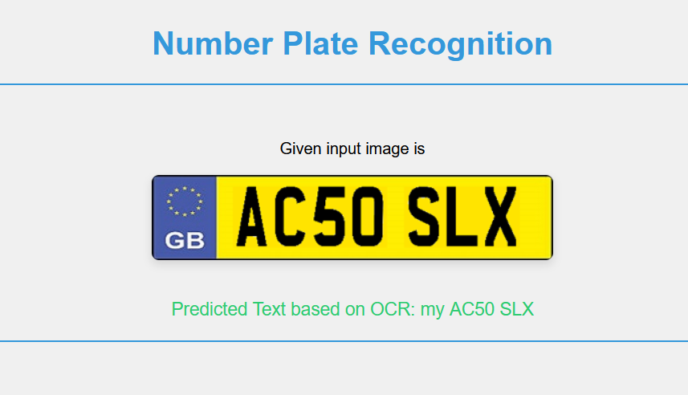
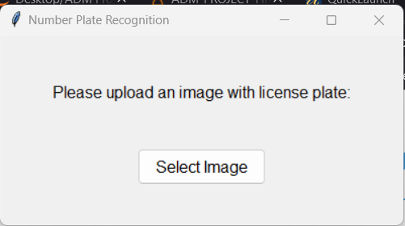
Output
You will see this window first.
After selecting image, you will see output as follows:

Slide 13
Analysis and Insights
In terms of key findingsx, our model presently demonstrates commendable accuracy in recognizing license plate characters, consistently achieving results that align with our expectations.
The precision of character recognition remains under ongoing scrutiny, contributing to reliable and trustworthy outputs. A particularly encouraging observation is the model's ongoing robustness to varied conditions, efficiently handling challenges such as changes in lighting, diverse weather conditions, and different license plate designs.
This ongoing robust performance enhances the model's reliability in real-world scenarios, reinforcing its practical applicability.

Slide 14
Analysis and Insights
The impact of transfer learning with pre-trained models like VGG16 or ResNet continues to be a noteworthy aspect of our model's development. This ongoing approach expedites training processes and contributes significantly to the model's overall effectiveness.
In terms of interesting patterns and observations, our model presently exhibits a fascinating capability to recognize characters in distinct fonts commonly found on license plates. This ongoing flexibility in font recognition enhances the model's applicability to a wide range of license plate designs.
Additionally, our model's efficiency in real-time processing remains a key observation. Ongoing analysis indicates that our model exhibits efficient real-time processing capabilities, a crucial attribute for applications such as traffic management, where swift and accurate recognition is imperative

Slide 15
Analysis and Insights
Collectively, these ongoing findings emphasize the present success of our model in addressing the complexities associated with Number Plate Recognition.
Its robust performance across diverse conditions and its ongoing ability to generalize contribute to its practical applicability in real-world scenarios.
The observed efficiency in real-time processing further solidifies our solution as a promising tool for tasks requiring rapid and accurate license plate recognition.

Slide 16
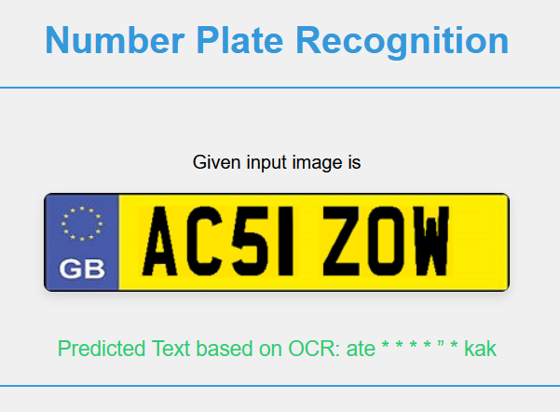
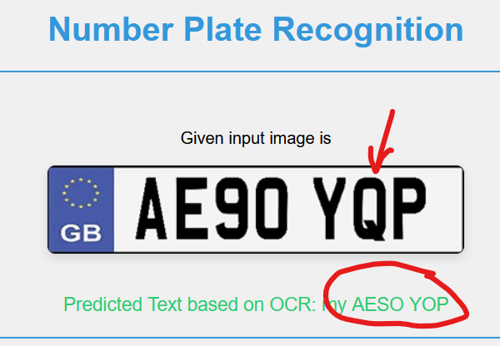
Challenges
The model is not accurate 100%. That means there are some plates, which the model is unable to recognize. Below are the examples.

Slide 17
FUTURE SCOPE
First order is improving the model’s accuracy and correct predictability.
Looking ahead, there are promising avenues for future work and improvement in our Number Plate Recognition project.
One potential area of exploration involves expanding the scope beyond merely recognizing number plates. We envision the possibility of extending our model to extract text from various parts of a vehicle, thereby enhancing its utility for broader applications.
This expansion could involve training the model to identify and decipher text present on different sections of a vehicle, such as bumper stickers or vehicle branding. Additionally, exploring the integration of video processing capabilities presents an exciting prospect.
The adaptation of our model to extract text from multiple vehicles within a video stream opens up opportunities for real-time applications, such as traffic surveillance or monitoring.

Slide 18
Acknowledgements
Open-Source Libraries and Frameworks:
Python: For providing a versatile and powerful programming environment.
OpenCV: Instrumental in image processing tasks.
PyTesseract: Facilitated optical character recognition.
Datasets:
UK Licence Plate Synthetic Images (Kaggle): Contributed to robust model training.
ALPR Character Train (Kaggle): Enriched dataset for character recognition.

Slide 19
References
"UK Licence Plate Synthetic Images" dataset. Kaggle.
https://www.kaggle.com/datasets/saadbinmunir/uk-licence-plate-synthetic-images
"ALPR Character Train" dataset. Kaggle.
https://www.kaggle.com/datasets/foolishboi/alpr-character-train
Python programming language.
https://www.python.org/
OpenCV library: https://opencv.org/
PyTesseract library: https://pypi.org/project/pytesseract/

